Slide 1
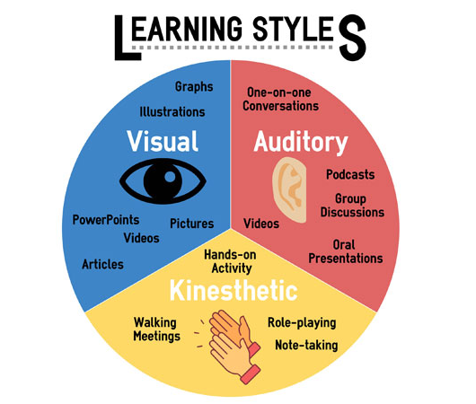
Learning Styles Classification Using natural language processing

Slide 2

Idea
Many schools use the learning styles of their students to improve academic outcomes.
The traditional method for identifying learning styles is to give students a questionnaire

Slide 3
Problem
The traditional method for identifying learning styles involves administering a questionnaire
inaccurate results

Slide 4
Solution
Predict the learning styles of a student based on analysis of their written sentences using deep learning and natural language processing.

Slide 5
Design
The student write English sentence
Text Preprocessing
input data to the model
learning styles prediction

Slide 6
dataset
Public: consists of 15,451 observations with 2 variables
Feature: a column containing English sentences
Target: a column indicating the learning style of the corresponding English sentence (either visual, auditory, or kinesthetic)

Slide 7
Data Preprocessing
Original Data | Visual | Auditory | Kinesthetic
Visual | 1 | 0 | 0
Auditory | 0 | 1 | 0
Kinesthetic | 0 | 0 | 1
Auditory | 0 | 1 | 0
Visual | 1 | 0 | 0
Convert the target column into numeric form using One Hot Encoding technique

Slide 8
Data Preprocessing
Removing duplicated values
Convert the target column into numeric form using One Hot Encoding technique
Convert the entire text into lower case
Removing stop words using spacy library
Removing digits
Removes all punctuation

Slide 9
Example
Original Sentence: The quick brown fox JUMPS OVER the lazy dog. 123
After text preprocessing: quick brown fox jumps lazy dog

Slide 10
Exploratory Data Analysis
I looked at the most frequent words in each class sentences

Slide 11
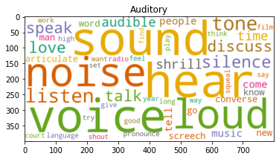
Auditory
[('sound', 490), ('hear', 469), ('voice', 397), ('noise', 345), ('loud', 337), ('listen', 325), ('tone', 318), ('silence', 314), ('discuss', 305), ('love', 263), ('speak', 244), ('talk', 217), ('like', 196), ('audible', 173), ('shrill', 168), ('time', 164), ('people', 145), ('tell', 128), ('come', 126), ('music', 125), ('articulate', 123), ('word', 120), ('screech', 110), ('know', 109), ('new', 107), ('converse', 99), ('man', 96), ('go', 95), ('pronounce', 89), ('say', 87), ('language', 87), ('shout', 85), ('think', 81), ('work', 80), ('want', 79), ('radio', 79), ('long', 77), ('find', 74), ('good', 74), ('year', 73), ('way', 72), ('give', 72), ('court', 71), ('high', 69), ('film', 68), ('try', 67), ('play', 66), ('set', 64), ('squeal', 64), ('feel', 62)]

Slide 12
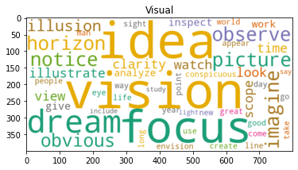
Visual
[('idea', 329), ('vision', 327), ('focus', 321), ('dream', 320), ('picture', 318), ('horizon', 316), ('notice', 311), ('imagine', 308), ('observe', 308), ('obvious', 305), ('illusion', 305), ('clarity', 302), ('illustrate', 302), ('view', 237), ('look', 216), ('watch', 208), ('scope', 206), ('time', 204), ('inspect', 178), ('like', 173), ('give', 153), ('analyze', 151), ('work', 151), ('conspicuous', 147), ('people', 146), ('appear', 130), ('new', 126), ('sight', 124), ('come', 118), ('take', 118), ('create', 118), ('year', 117), ('way', 116), ('good', 113), ('world', 110), ('great', 104), ('use', 104), ('day', 103), ('long', 102), ('line', 99), ('life', 97), ('eye', 95), ('point', 95), ('go', 87), ('envision', 85), ('man', 84), ('light', 80), ('study', 77), ('say', 76), ('include', 74)]

Slide 13
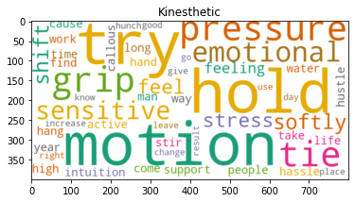
Kinesthetic
[('try', 489), ('hold', 349), ('motion', 327), ('pressure', 322), ('grip', 310), ('tie', 309), ('emotional', 305), ('sensitive', 302), ('softly', 281), ('shift', 250), ('stress', 199), ('feel', 189), ('feeling', 187), ('support', 168), ('active', 166), ('time', 166), ('intuition', 154), ('hang', 144), ('like', 136), ('hassle', 123), ('people', 121), ('water', 116), ('high', 105), ('work', 99), ('take', 96), ('year', 95), ('stir', 94), ('life', 90), ('hand', 88), ('way', 87), ('hustle', 87), ('man', 85), ('find', 85), ('come', 83), ('callous', 83), ('long', 81), ('cause', 80), ('change', 79), ('go', 76), ('good', 75), ('know', 75), ('increase', 74), ('leave', 70), ('use', 69), ('place', 68), ('result', 67), ('give', 66), ('right', 66), ('hunch', 66), ('day', 65)]

Slide 14
parts of a neural network model architecture

Slide 15
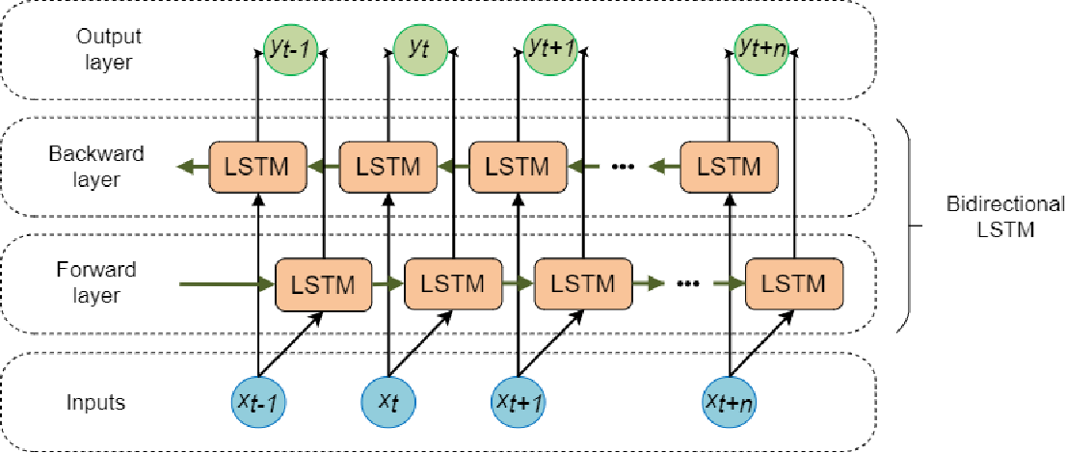
bidirectional long short-term memory (LSTM) layer
It is a type of recurrent neural network (RNN) layer that processes input data in both forward and backward directions. An LSTM layer processes input data sequentially, using a memory cell and three gates (input, forget, and output) to control the flow of information into and out of the cell. A bidirectional LSTM layer processes the input data in both forward and backward directions, using two separate LSTM layers for each direction. The outputs from the two LSTM layers are then concatenated, allowing the model to capture contextual information from both past and future time steps.

Slide 16
GlobalMaxPool1D Layer
It is a special case of max pooling where the window size is the entire spatial dimension of the input, such that the output of the pooling layer is a tensor with a single element. For example, suppose we have an input tensor with shape (batch_size, time_steps, features), and we apply GlobalMaxPool1D to this tensor. The output tensor will have the shape (batch_size, features), where each element in the output is the maximum value of the corresponding feature over all time steps.

Slide 17
Dropout Layer
It is a regularization technique that randomly sets a fraction of the input units to zero during training, which helps to prevent overfitting and improve the generalization ability of the model

Slide 18
Early Stopping Callbacks
It is a technique used to prevent overfitting in deep learning models. It involves monitoring the performance of the model on a validation set during training and stopping the training process when the performance stops improving.

Slide 19
Categorical cross entropy Loos Function
it is a loss function used for classification tasks with multiple classes, and it is a measure of the difference between the true distribution of the classes and the predicted distribution of the classes. The output label is assigned a one-hot category encoding value in form of 0s and 1.

Slide 20
Adam optimizer
It is an alternative optimization algorithm that provides more efficient neural network weights by running repeated cycles of “adaptive moment estimation.” Adam extends on stochastic gradient descent to solve non-convex problems faster while using fewer resources than many other optimization programs.

Slide 21
Batch size
It is the number of samples processed by the model in a single forward/backward pass. The batch size is a hyperparameter that can have a significant impact on the performance and efficiency of the model.

Slide 22
Rectified Linear Activation Function (ReLU)
The Rectified Linear Unit is the most commonly used activation function in deep learning models. The function returns 0 if it receives any negative input, but for any positive value x it returns that value back. So it can be written as f(x)=max(0,x)

Slide 23
Softmax Activation Functions
The softmax activation function transforms the raw outputs of the neural network into a vector of probabilities, essentially a probability distribution over the input classes. Consider a multiclass classification problem with N classes.

Slide 24
models and result

Slide 25
Doc2Vec model

Slide 26
Steps
Preprocess the text data: This typically involves tokenizing the text into individual words or tokens
Create a list of Tagged Document objects: Tagged Document is a class in genism that represents a document as a list of words with an associated label or tag. to create a list of Tagged Document objects we need to iterate over the preprocessed text data and create a Tagged Document for each document.
Train the Doc2Vec model: I use the Doc2Vec class in genism to train a Doc2Vec model on the list of Tagged Document objects.
Extract the Doc2Vec embeddings: use the docvecs attribute to get the trained Doc2Vec embeddings for each document

Slide 27
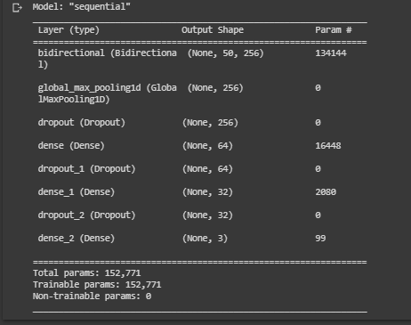
model architecture

Slide 28
Results
 | precision | recall | f1-score
Auditory | 0.75 | 0.76 | 0.76
Kinesthetic | 0.73 | 0.77 | 0.75
Visual | 0.79 | 0.75 | 0.77
Overall Accuracy |  |  | 0.76

Slide 29
Word Embedding model

Slide 30
Steps
Preprocess the text data: This typically involves tokenizing the text into individual words or tokens
use texts to sequences function: this is a function in TensorFlow that is used to convert a list of texts into a list of sequences of integers
Use pad sequence’s function: this is a function in TensorFlow that is used to pad sequences of data to a fixed length. The pad sequence’s function allows you to do this by adding padding elements (usually zeros) to the shorter sequences so that they all have the same length
using the numerical text data as an input for the model

Slide 31
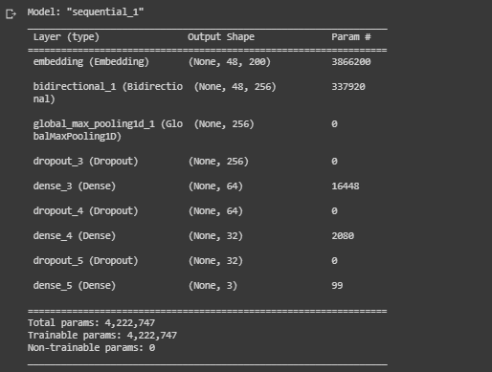
model architecture

Slide 32
Results
 | precision | recall | f1-score
Auditory | 0.95 | 0.94 | 0.95
Kinesthetic | 0.95 | 0.98 | 0.97
Visual | 0.96 | 0.95 | 0.96
Overall Accuracy |  |  | 0.96

Slide 33

future work
Improving models
processing paragraphs instead of sentences
detecting multi method of learning detection

